Slide 1

CS144 An Introduction to Computer Networks
The Link Layer
aka Physical Layer
Nick McKeown
Professor of Electrical Engineering
and Computer Science, Stanford University
Notes:
You will remember from an earlier video that if a network is carrying only one flow, AIMD will keep the bottleneck link full all the time, and therefore we say the throughput is equal to the data rate of the bottleneck link. Nice and simple.
Things get quite a bit more complicated if the network is carrying lots of AIMD flows, all sharing a bottleneck link. In this video, I am going to derive a throughput formula for AIMD with multiple flows sharing the network. This video contains more equations than most of the videos, so keep your wits about you and keep a close eye on the assumptions I am making as I go along.

Slide 2
Goals for today
Capacity: What determines the maximum data rate of a link?
How can we get close to the maximum capacity?
Clocks: Two communicating entities cannot have exactly the same clock or frequency. How can they communicate?

Slide 3
The 4 Layer Internet Model
Source End-Host
Destination End-Host
Application
Application
Transport
Transport
Router
Router
Network
Network
Network
Network
Link
Link
Link
Link
Notes:
The next layer up is, for us, the most important layer: the Network layer.
The network layer’s job is to deliver packets end-to-end across the Internet from the source to the destination.
A packet is an important basic building block in networks. A packet is the name we give to a self-contained collection of data, plus a header that describes what the data is, where it is going and where it came from. You will often see packets drawn like this: <draw a packet with header and data>
Network layer packets are called datagrams. They consist of some data and a head containing the “To” and “From” addresses – just like we put the “To:” and “From” addresses on a letter. <Draw a datagram with To/From addresses> .
The Network hands the datagram to the Link Layer below <click to wipe arrows down>, telling it to send the datagram over the first link. In other words, the Link Layer is providing a *service* to the Network Layer. Essentially, the Link Layer says: “if you give me a datagram to send, I will transmit it over one link for you”.
At the other end of the link is a router. The Link Layer of the router accepts the datagram from the link, and hands it up to the Network Layer in the router. The Network Layer on the router examines the destination address of the datagram, and is responsible for routing the datagram one hop at a time towards its eventual destination. It does this by sending to the Link Layer again, to carry it over the next link. And so on until it reaches the Network Layer at the destination. <sequence of clicks shows the steps>
Notice that the Network Layer does not need to concern itself with *how* the Link Layer sends the datagram over the link. In fact, different Link Layers work in very different ways; Ethernet and WiFi are clearly very different. This separation of concerns between the Network Layer and the Link Layer allows each to focus on its job, without worrying about how the other layer works. It also means that a single Network Layer has a common way to talk to many different Link Layers by simply handing them datagrams to send. This separation of concerns is made possibly by the modularity of each layer and a common well-defined API to the layer below.

Slide 4

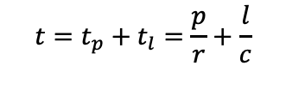
Total time to send a packet across a link: The time from when the first bit is transmitted until the last bit arrives.
l
p
r bits/s
$$t=t_{p}+t_{l}=\frac{p}{r}+\frac{l}{c}$$
Example: A 100bit packet takes 10 + 5 = 15μs to be sent at 10Mb/s over a 1km link.

Slide 6
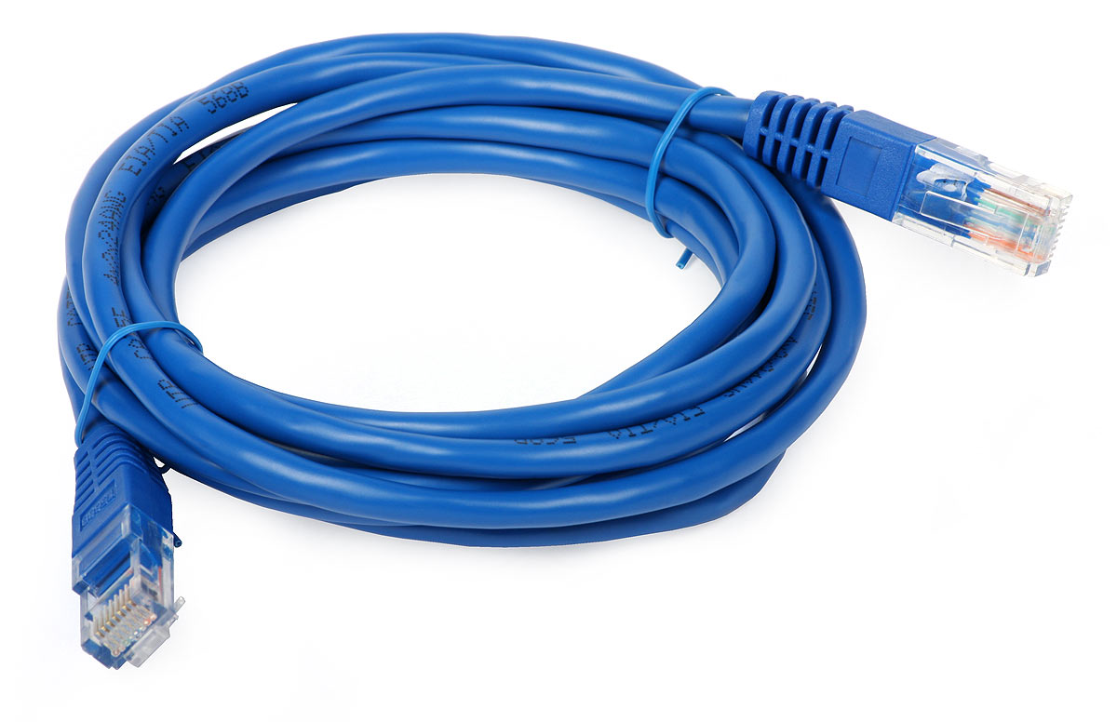
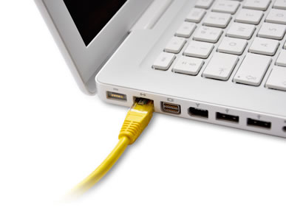
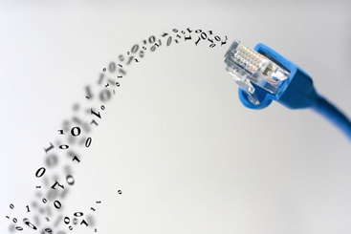
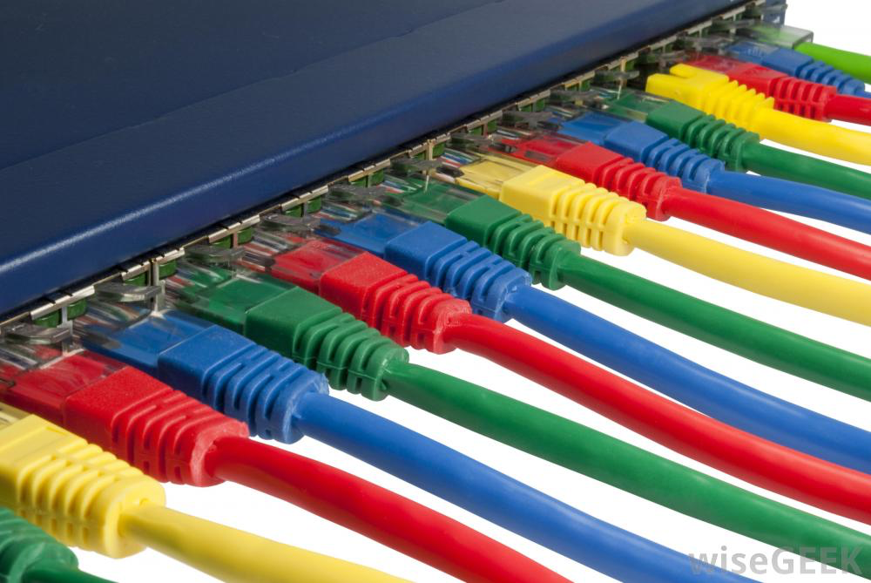

Slide 7
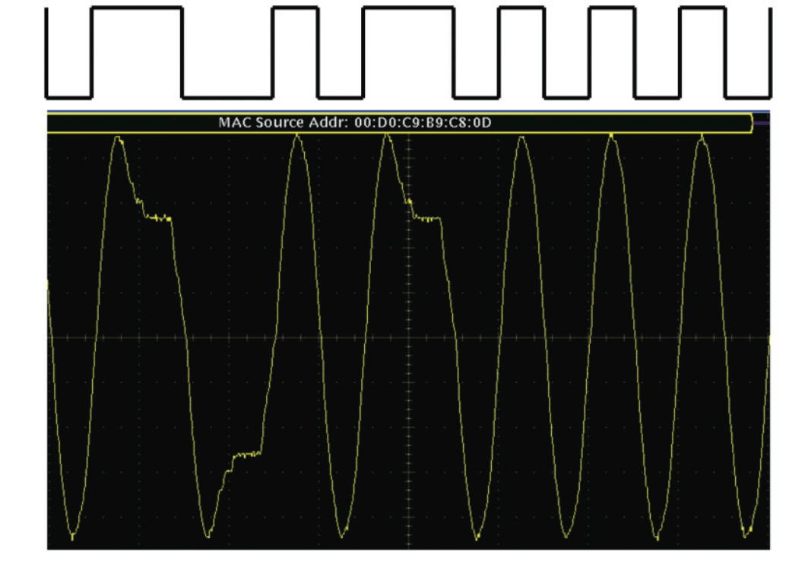
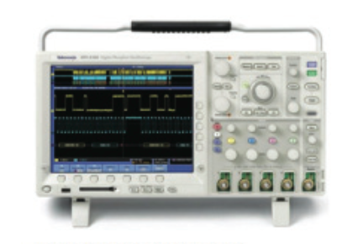
IP addresses
Source Destination
Example of “On-Off Keying”
Data
171.64.74.55
176.22.45.66
Volts
+5V
“176”
1
0
end
start
0V
10110000
time
Data
0
1
1
0
0
1
0
1
1
0
1
0
1
0
1
0
Signal
Notes:
Internet RFCs assume byte order is Big-Endian (MSByte first), as described in RFC1700/STD2. However, Ethernet is bit little-endian (Lsbit sent first on the wire).
Why isn’t the wave measured by the oscilloscope perfectly square?
But why is it the same each time the signal is sent? (repeatible because memoriless, LTI system, and in this case very little noise).

Slide 8
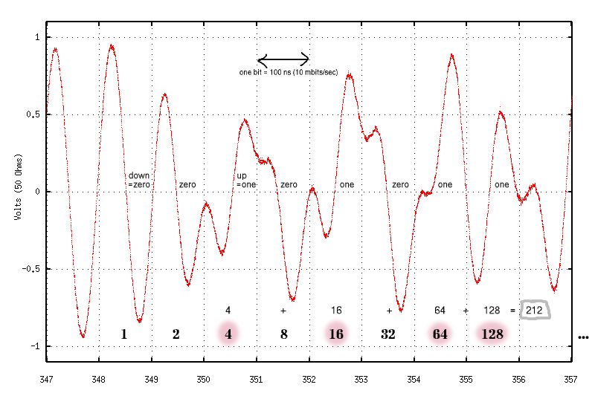
Keith: So what was this about?

Slide 9
What determines the data rate?
Q: What determines the steepness (i.e. rate) of this change?
Q: How does the rate of change affect the data rate?
Data
0
1
1
0
0
1
0
1
1
0
1
0
1
0
1
0
Signal

Slide 10
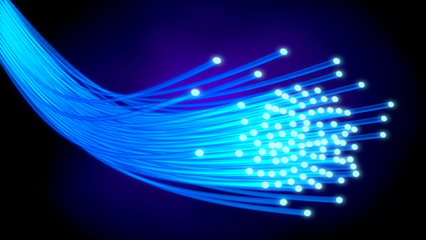
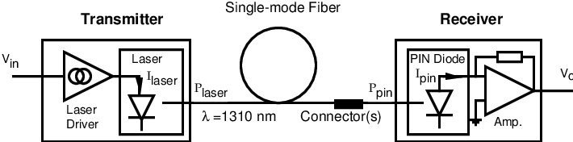
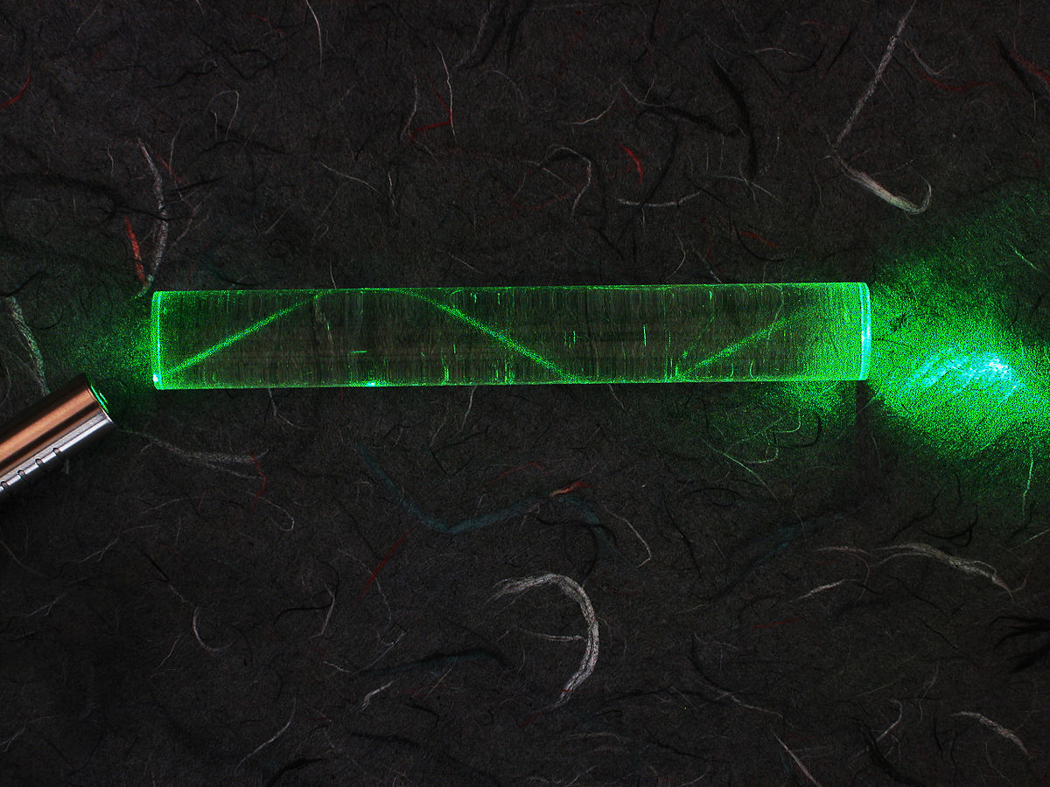
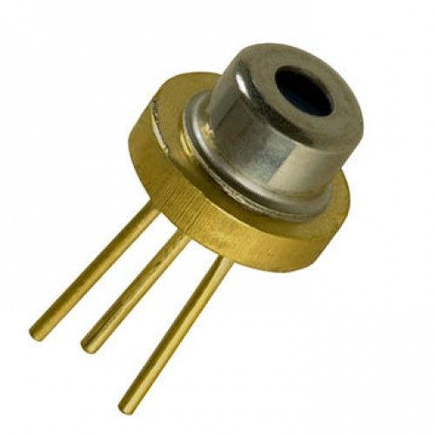
Fiber-optic communication links
Each fiber is smaller
than a human hair
Commercial lasers can be be switched on/off at rates above 100GHz
Light travels through the fiber because of total internal reflection
Notes:
In a FO link, the laser can turn on and off faster (i.e. the transition is faster), hence the data rate is faster. However, the propagation speed is about the same.

Slide 11
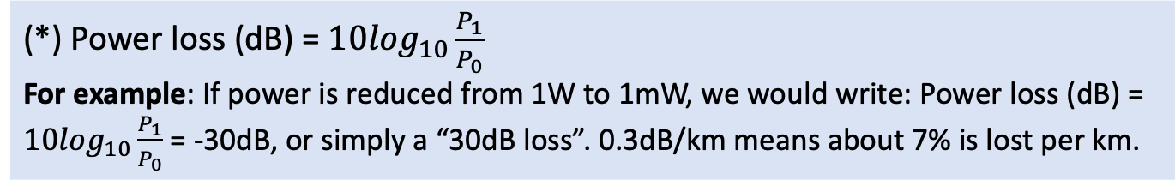
Characteristics of fiber-optical links
High bandwidth:
Lasers can be switched on/off very fast. (“very steep rate of change”)
The signal remains the same for a long distance (“low dispersion or spreading”)
Multiple signals of different colors can be sent over a cable simultaneously (“wavelength division multiplexing” or WDM).
Low signal loss: Typically 0.3dB/km (*)
Electromagnetic interference immunity: An opaque jacket means light cannot enter the cable. Total internal reflection means it is very hard to detect the signal outside the cable.
(*) Power loss (dB) = $10\log_{10}\frac{P_{1}}{P_{0}}$
For example: If power is reduced from 1W to 1mW, we would write: Power loss (dB) = $10\log_{10}\frac{P_{1}}{P_{0}}$ = -30dB, or simply a “30dB loss”. 0.3dB/km means about 7% is lost per km.
Notes:
From Wikipedia: In 1880 Alexander Graham Bell and his assistant Charles Sumner Tainter created a very early precursor to fiber-optic communications, the Photophone, at Bell's newly established Volta Laboratory in Washington, D.C. Bell considered it his most important invention. The device allowed for the transmission of sound on a beam of light. On June 3, 1880, Bell conducted the world's first wireless telephone transmission between two buildings, some 213 meters apart

Slide 12
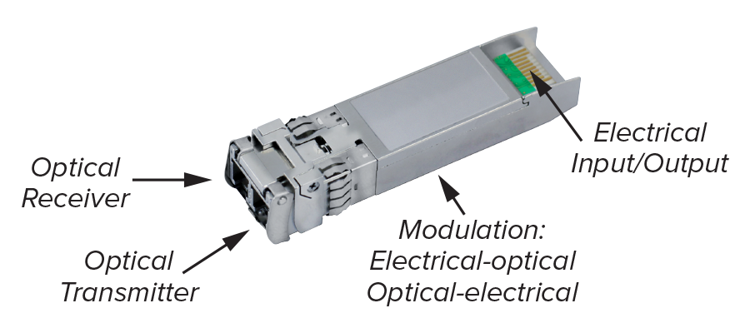
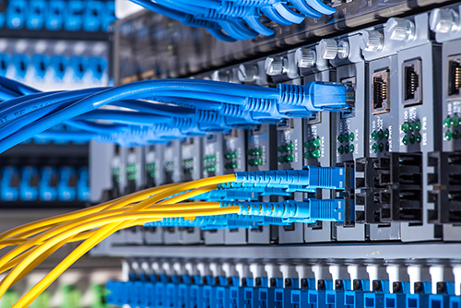
Fiber-optic communication links
Optical fibers and modules on the front panel of communication equipment
Typically used for very long and/or very fast communications
Long haul links in the public Internet, e.g. 200km @ 400 Gb/s
To connect buildings on campus, e.g. 2km @ 100Gb/s
Between racks of equipment in a data center, e.g. 50m @ 100Gb/s
World-record NEC (2011) 101.7 Tb/s over 370 WDM channels at 165km!
Notes:
In a FO link, the laser can turn on and off faster (i.e. the transition is faster), hence the data rate is faster. However, the propagation speed is about the same.

Slide 13
What determines the maximum data rate of a cable, fiber, wireless link, etc?
Q: What happens if we put the “bits” closer and closer together?
Q: If we can’t put them closer together, how can we increase the number bits of information transmitted per second?
Q: What other factors limit the number of bits per second we can transmit?
Q: Are there any other factors other than “Bandwidth” and “Noise” that determine the maximum data rate of a channel?
Notes:
Q: What happens if we put the “bits” closer and closer together?
Ultimately limited by how close they fit together, which is determined by the maximum rate of change of the medium, which is characterized by its bandwidth.
Q: If we can’t put them closer together, how can we increase the number bits of information transmitted per second?
We could, for example, carry more bits at a time by using different levels. E.g. 4 levels to represent two bits, etc.
Q: What other factors limit the number of bits per second we can transmit?
Ultimately, our ability to distinguish one bit from another. i.e. limited by NOISE and BANDWIDTH

Slide 14
Claude Shannon
1937: MS Thesis proposed using Boolean algebra for digital circuit design.
1948: “A Mathematical Theory of Communication” led to the field of Information Theory and Shannon Capacity
Claude Shannon (1916 – 2001)
Mathematician, Electrical Engineer
Notes:
His 1937 thesis, aged 21, created the foundation for digital circuits and therefore computers.
His 1948 Bell Systems Journal Memorandum described his work in WW2
MIT faculty 1956-1978

Slide 15
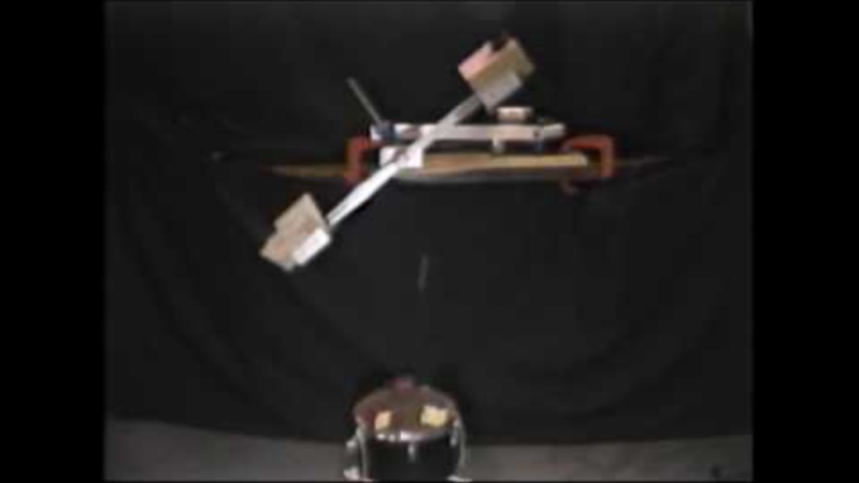
Shannon’s Juggling Machines https://www.youtube.com/watch?v=dyc5bgpY86c

Slide 16
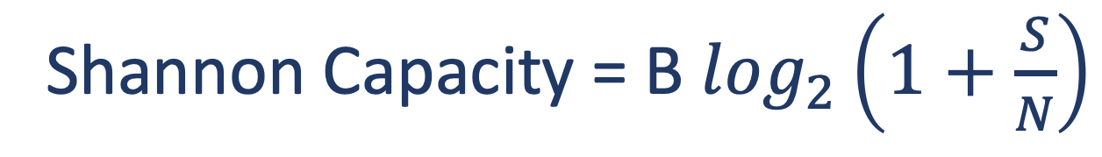
Shannon Capacity
Shannon capacity is the maximum error-free rate we can transmit through a channel (e.g. wire, fiber, air, …).
The maximum “data rate”.
Under some mild assumptions:
In other words, it depends only on Bandwidth and Signal-to-Noise ratio!
EE376A: Information Theory. Wow.
Shannon Capacity = B $\log_{2}\left(1+\frac{S}{N}\right)$

Slide 17

Shannon Capacity
But: It doesn’t tell us how to achieve the capacity.
Hence: Huge numbers of researchers and engineers have spent decade trying to approach it, in different contexts:
WiFi
Cellular telephones
Ethernet
Optical Fibers
ADSL Broadband access
Modems
…

Slide 18
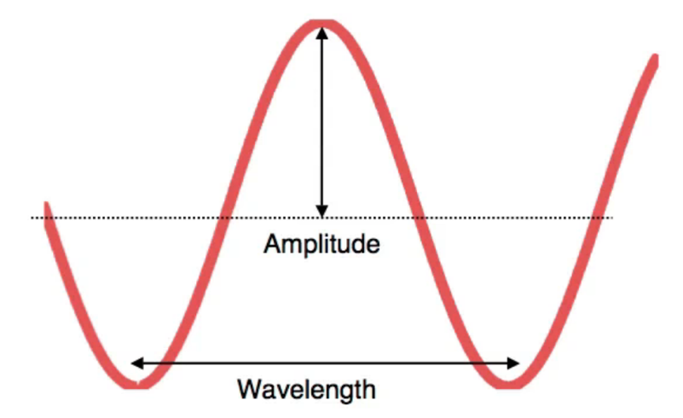
Analog signals
On-Off Keying (OOK)
One frequency
2 amplitudes
Frequency = 1/wavelength
Bandwidth: size of frequency range
Phase: location of peak within the wavelength

Slide 19
Sending 0s and 1s
Frequency Shift Keying (FSK)
Amplitude Shift Keying (ASK)
Phase Shift Keying (PSK)
For the same frequency + amplitude, vary the phase
No variation in power (amplitude) or wavelength (frequency)

Slide 20
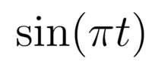
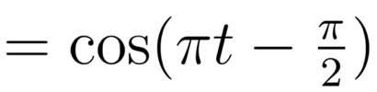
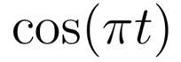
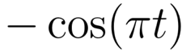
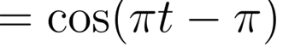
Phase in Analog signals
(-90°)
(-180°)
Same frequency
Same amplitude
Different phase

Slide 21
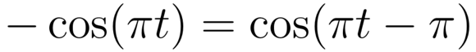
Phase in Analog signals
–π/2 (–90°)
–π (–180°)
0°
–3π/2 (–270°)
(-180°)
Same frequency
Same amplitude
Different phase

Slide 22
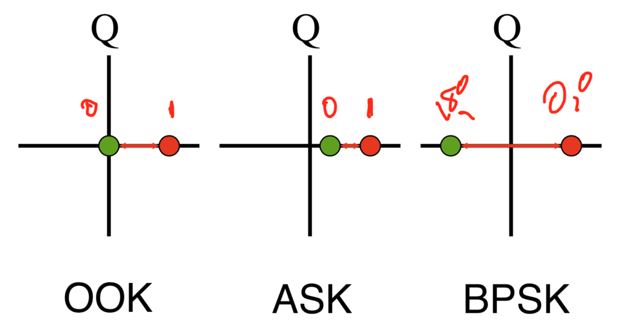
I/Q constellations
For the same frequency:
What I/Q constellation (amplitude, phase) should I select?
How should I assign a symbol (amplitude, phase) = to bits?

Slide 23
Quadrature Phase Shift Keying (QPSK)
–135°
–45°
For each symbol:
What is the amplitude?
What is the phase?
Represent each symbol as a bit (or bits).
R
–225°
–315°

Slide 24
Quadrature Amplitude Modulation (16-QAM)
How many symbols?
How many amplitude variations?
How many phase variations?
How many bits per symbol?

Slide 25
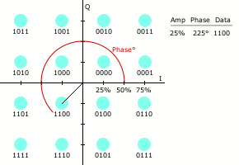
Example 32 bit word transmission using 16-QAM
1100 1001 0100 1110 1100 0110 1100 1111
0
1
2
3
4
5
6
7

Slide 26
Examples today
ASK/OOK: Wired Ethernet
FSK: Bluetooth
BPSK: 802.11 abgn
QPSK: 802.11 abgn, LTE
16-QAM: 802.11abgn, LTE
64-QAM: 802.11 abgn, LTE, 5G
256-QAM: 5G
1024-QAM: Home powerline communication
32768-QAM: ADSL (digital data over long telephone cables)

Slide 27
Clocks

Slide 28
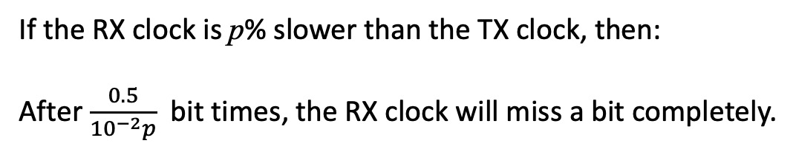
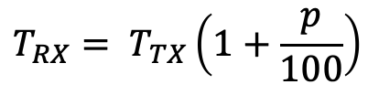
If we don’t know the sender’s (TX) clock
T_{Tx}
TX Clock
Data
Missed!
Usually expressed in parts per million (ppm) rather than percentage
RX Clock
T_{Rx}
If the RX clock is p% slower than the TX clock, then:
After $\frac{0.5}{{10}^{−2}p}$ bit times, the RX clock will miss a bit completely.
$$T_{RX}= T_{TX}\left(1+\frac{p}{100}\right)$$

Slide 29
Synchronous communication on network links
TX clock domain
RX clock domain
A
Flip-
Flop
network
link
Flip-
Flop
Flip-
Flop
Sender’s Clock
10MHz clock
+/- 100ppm
Clock Recovery
Unit
10MHz clock
+/- 100ppm
Notes:
Problem:
Different hosts use locally-generated clocks of nominally the same frequency, but slightly different. E.g. 10MHz +/- 100ppm (“parts per million”). E.g. 100ppm = 10e-4%
The receiver needs to “recover” the senders clock from the data stream.
Clock recovry unit: This is a special circuit that takes the incoming signal and determines the clock used by the sender. It does this by examining the frequency and phase of the arriving bits. While the bit pattern could be anything, if there is a strong enough component in the spectrum from the sender’s clock, then the receiver will find it and use it to sample the bits. Examples of clock recovery circuits are: Phase Locked Loops (PLLs) and Delay Locked Loops (DLLs). In some cases, they use a very precise filter called a SAW filter, for surface acoustic wave. In the next slide I’m going to tell you about how we make life easier for the CRU by encoding the clock and the data together before we transmit it.
Once the bit has been sampled by the flip-flop, it is placed into a small FIFO. This FIFO is another special circuit to help us take the bit from the sender’s clock domain to the receiver’s clock domain. Why? Because we need to get the bit into the clock domain of the reciver so it can process the packet using its own clock. To do this, the bit is written into the FIFO using the sender’s clock, and read out again using the receiver’s clock. The FIFO is different from the ones we used before where we assumed the clock is the same on both sides. This FIFO is carefully designed to let us do this using two clocks. Once the bit emerges from the other side, it is now in the clock domain of the receiver.
The FIFO is called an ELASTICITY BUFFER and you may be wondering how big it is. At first glance it’s not at all obvious: If we write into it at a faster rate than we read out, we know what happens … it will eventually overflow. In a few minuts I’ll explain how we design the whole system so we never overflow or underflow the elasticity buffer.

Slide 30
Encoding for clock recovery
Sampling points
Data
Clock
If the clock is not sent separately, the data stream must have enough transitions for the receiver to determine when to sample the arriving data.
Notes:
If the clock was sent SEPARATELY – as it is on the circuit board of a computer or between different parts of a circuit on a chip – life would be pretty simple. We could simply use the clock to feed into a Flip flop and capture the bits in the same clock domain everywhere.

Slide 31
Encoding for clock recovery Example #1: 10Mb/s Ethernet
Data
0
1
1
0
1
0
1
1
“Manchester
Coding”
Clock
Advantages of Manchester encoding:
Guarantees one transition per bit period.
Ensures d.c. balance (i.e. equal numbers of hi and lo).
Disadvantages
Doubles bandwidth needed in the worst case.
Notes:
DC Balance: makes it easy to set the threshold between the 1 and the 0 at the receiver.
Why is the b/w doubled?
Consider a stream of all 1’s being sent by transmitter … twice as many transitions, which means the dominant frequency component of the signal has now been increased. If we are running over a cable and trying to make it as fast as we can, this is a problem – we have now wasted some of the precious b/w.

Slide 32
IP addresses
Source Destination
Data
171.64.74.55
176.22.45.66
“176”
end
start
10110000
Data
1
0
1
1
0
0
0
0
Manchester Encoded Data
0
1
1
0
0
1
0
1
1
0
1
0
1
0
1
0
Signal

Slide 33
Encoding for clock recovery Example #2: 4b/5b encoding
4-bit data | 5-bit code
0000 | 11110
0001 | 01001
0010 | 10100
… | …
Advantages of 4b/5b encoding:
More bandwidth efficient (only 25% overhead).
Allows extra codes to be used for control information.
Disadvantages
Fewer transitions makes clock recovery a little harder.

Slide 34
Elasticity Buffer
TX clock domain
RX clock domain
A
Flip-
Flop
network
link
Flip-
Flop
Flip-
Flop
Sender’s Clock
10MHz clock
+/- 100ppm
Clock Recovery
Unit
10MHz clock
+/- 100ppm
Notes:
DRAW Label the FIFO. Label its size, B. Label the rates R_tx and R_rx on the links before and after the FIFO.
The main question we need to answer is: How big should the Elasticity Buffer be?
Well, we already know how to answer this question – we can use the same deterministic model we used for playback buffers, and rate and delay guarantees when we learned about packet switching.
The key things we need to know are:
1. If R_tx > R_rx, we risk overflowing the buffer. Therefore, we will insert a short interpacket gap between transmitted packets so the buffer can drain again.
2. If R_rx > R_tx, we risk underflowing the buffer in the middle of a packet. In other words, we read from the FIFO and there is nothing there and we end up with a hole in a packet. Not good. Therefore, we will WAIT until the buffer has got enough data in it before reading it, so that it doesn’t go empty before the end of the packet.

Slide 35
Sizing an elasticity buffer
R_{rx} > R_{tx}
Transmitted bits
B
Cumulative bits
Received bits
R_{tx} > R_{rx}
time
Notes:
First, consider the case where the senders clock is faster than the receivers clock, i.e. R_tx > R_rx.
AT some point, if we don’t do anything, the buffer must reach its maximum and then overflow. We can prevent that by putting in an IPG. DRAW IT: horizonal transmitted bits, and the received bits will catch up.
This means there is a minimum IPG we can tolerate, so we can be sure to deplete our buffer far enough before the next packet starts to arrive.
Now consider what happens in the case where the senders clock is slower than the receivers clock, i.e. R_rx > R_tx.
At some point, the buffer will go empty. MARK crossing point. We therefore let the buffer accumulate some bits first, before the packet starts, to let the buffer have enough of a reservoir to not go empty before the packet ends. This limits the size of the packet we can have for a given clock tolerance: It tells us how long we can go without replenishing our reserve of bits.

Slide 36
Sizing an elasticity buffer
B
R_{tx}
R_{rx}
Hold buffer nominally at B/2.
At start of new packet, allow buffer to fill to B/2.
Or, make sure buffer drains to B/2 before new packet.
Size buffer so that it does not overflow or underflow before packet completes.
(R_{tx} > R_{rx}): Given inter packet gap, size B/2 for no overflow.
(R_{rx} > R_{tx}): Given max length packet, pick B/2 for no underflow.

Slide 37
Preventing overflow
Bits leaving FIFO
Cumulative bits
Interpacket
gap
Bits going into FIFO
To prevent overflow:
Max
Packet
Size, P_{max}
R_{max}
R_{min}
B/2R_{max}
P_{max}/R_{max}
time

Slide 38
Preventing underflow
Bits leaving FIFO
Cumulative bytes
Interpacket
gap
Bits going into FIFO
Max
Packet
Size, P_{max}
To prevent underflow:
R_{min}
R_{max}
B/2R_{min}
(P_{max}/R_{max}) + (B/2R_{min})
time

Slide 39
Sizing an elasticity buffer Example
Maximum packet size 4500bytes
Clock tolerance +/- 100ppm
Therefore,
Elasticity buffer needs to be at least 14 bits
Wait for at least 7 bits before draining buffer
Inter-packet gap at least 7 bits

